Slide 1
Change Through Reporting
Nik Clement
19 Sep 17
Notes:
This presentation is used a base for a range of improvement tasks and slides are used in other presentations as required.

Slide 2
Agenda
Change Framework
Case Study
Performance Improvement Framework

Slide 3
Change Framework
People
Process
Technology
Notes:
Change is made up of the effect of actions on the components of the system.
Normally people focus on the technology, however of the three components it is arguably the easiest and most well understood. This is either attributable to the personality types engaged in the work or the ease of determining whether the result has achieved the desired state or not.
Process describes the way in which tasks are performed, both as described as in formal policy and procedure documents and how it actually works in reality which may not be the same thing. Organisatoinal Culture has an impact on how process development has occurred and will influence how change is received.
People is where change gets hard, as patience is tested when results are not as instant as executives expect. The waving of hands and incantation of the words transformation mean little to those most affected by whatever change is occurring.

Slide 4
Technology
Project Management
Architecture
Strategic Fit
Sponsorship
Signoff
Notes:
This slide lists a range of factors that impact a project.
Most likely these won’t be specified tasks, but will fit into the implied tasks that actually generate 90% of the work in a project.

Slide 5
Process
The ability to improve a process through a number of steps, the path chosen will depend on the amount of change required
How do you fill the Gap ??
Process Measurement (Current State)
Performance Goal
(Future State)

Slide 6
Process
The ability to improve a process through a number of steps, the path chosen will depend on the amount of change required
Process Redesign
Process Measurement (Current State)
Performance Goal
(Future State)
Process Improvement

Slide 7
People
The biggest impediment to change is fear
How do you reduce fear
Experiments
Rolling Back unsuccessful experiments

Slide 8
Steps to Future State
Future
Current
Notes:
When planning transformation or change it is important to create the shared vision of the future state that is both aspirational and achievable, this occasionally requires intermediate goals.
The most important part of the process is removing the fear in the first step, making it as small as possible as rolling the change/experiment back if it doesn’t work. Each successive step should extend the length of the step.
The real step change occurs when the people start designing and running their own experiments with a reduced input from whatever support is being used to champion the initiative.

Slide 9
Case – Allied Health Workforce Reporting
Allied Health
Monthly reporting requirement
Workforce recorded on bit of paper
Lack of standardisation
Award Code Hierarchy
Automated input feed from payroll
Single report
Update process
Notes:
Allied Health are pretty much the clinical workers who aren’t Doctors (medical) or Nurses.
There was a monthly reporting requirement split across Workforce and Activity (Occasions of Service)
When started the Allied Health managers were recording their workforce data on scraps of paper.
This resulted in no two managers interpreting the results in the same way, reducing the transferability of knowledge and skills, increasing the time required to manage the capability.
The first step in resolving the issue was standardising the definition of who was included when counting people, achieved by creating a hierarchy of award codes, putting Allied Health on the same reporting framework as Medical and Nursing.
This allowed the automated weekly and fortnightly data feeds relating to Workforce data (Payroll, FTE, Leave Balances) to be used unaltered to allow reporting to be developed.
The initial attempt at reporting answer a range of questions relating to the monthly reporting requirement, in a eureka moment whilst briefing two elderly managers that weren’t grasping the multiple reports used to compile the monthly report, the idea of putting it all on one page was generated. This ended up being one page, two sides, with the bottom half of the second page being the definitions of the terms, allowing managers who would only run this report once a month to be able to have a reference to what the data means, reducing questions and increasing manager productivity.
When the report was being briefed the technical resource was unavailable, so the manager who had done the data validation briefed their peers on the changes, weaving in the experienced gained during data validation with an additional set of notes prepared by the technical resource, providing a conduit for ongoing updates to be delivered in a way that didn’t cause fear of the unknown.

Slide 10
Case – Excessive Leave Reporting
Facility X 1700 Headcount 995 with Excessive Leave
HR manager calls first name
10-15 minutes of an already stretched resource will not ever solve the issue
Letters
Segmentation
Mail Merge from Excessive Leave lists
Includes leave plan form
Strategies
Cashouts
Letters
Directed Leave
After how many letters ?
Monitoring progress
Call Top 10

Slide 11
Process Recap
The ability to improve a process through a number of steps, the path chosen will depend on the amount of change required
Process Redesign
Process Measurement (Current State)
Performance Goal
(Future State)
Process Improvement

Slide 12
Information Decision Action (IDA)
Evidence Based Decision Making
Information
based on evidence
Decisions on solutions
Actions
implemented
Learn
It’s only the actions that make a difference

Slide 13
Six Sigma
With 5 measurements you have a process
Six Sigma (standard deviations) = 99.7% of possible outcomes
Signals
1 point outside control limits
8 points below or above mean (Run of Eight)
Signals are either:
Good (Green)
Bad (Red)

Slide 14
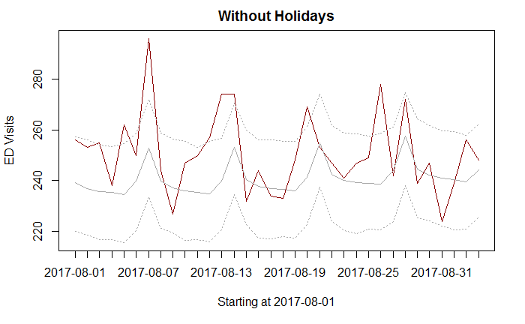
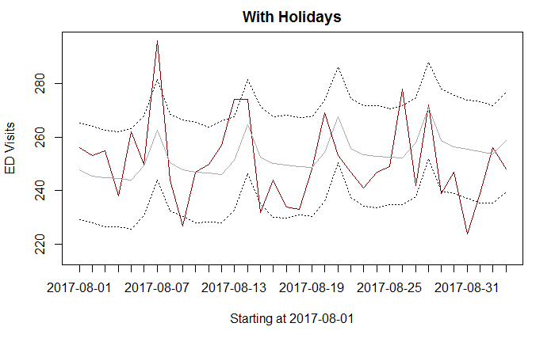
Insert Methodology Here
Prophet (R package)
RMSE
Without: 16.96093
With: 14.66894
Notes:
Explain the charts
It’s all about picking a methodology and applying it:
Lean
Six Sigma
SPC

Slide 15
Idea Categories
Radical change to achieve quantum
performance improvement
Long term (more than 6 months)
Addresses strategic core processes
Strategic
Projects
Streamline existing process, deploy best practices, etc..
Medium term (up to 6 months)
Addresses operational process
Focused
Improvement
Just do its: - immediate improvement opportunities
Short Term (days - weeks)
Improves efficiency and/or effectiveness
in day to day processes
Quick Hits
Notes:
Categories of Ideas:
5% Strategic Ideas
15% Focused Improvements
80% Quick Hits
Level of authority required to implement increases as you rise the hierarchy
What happens if a Quick Hit fails ? Record results and environmental factors, crack on.
What happens if a Strategic Project fails ? Results may vary

Slide 16
Performance Improvement Results
The end result of Performance Improvement is to embed Organisational Change & Development
Evidence Based Decision Making is the start to changing the way the organisation behaves
Cost savings and performance increases are used to justify the cost of implementation

